Slide 2
Content
Introduction
Overview
Sailboat Simulation
Motion Control System
Future Work

Slide 3
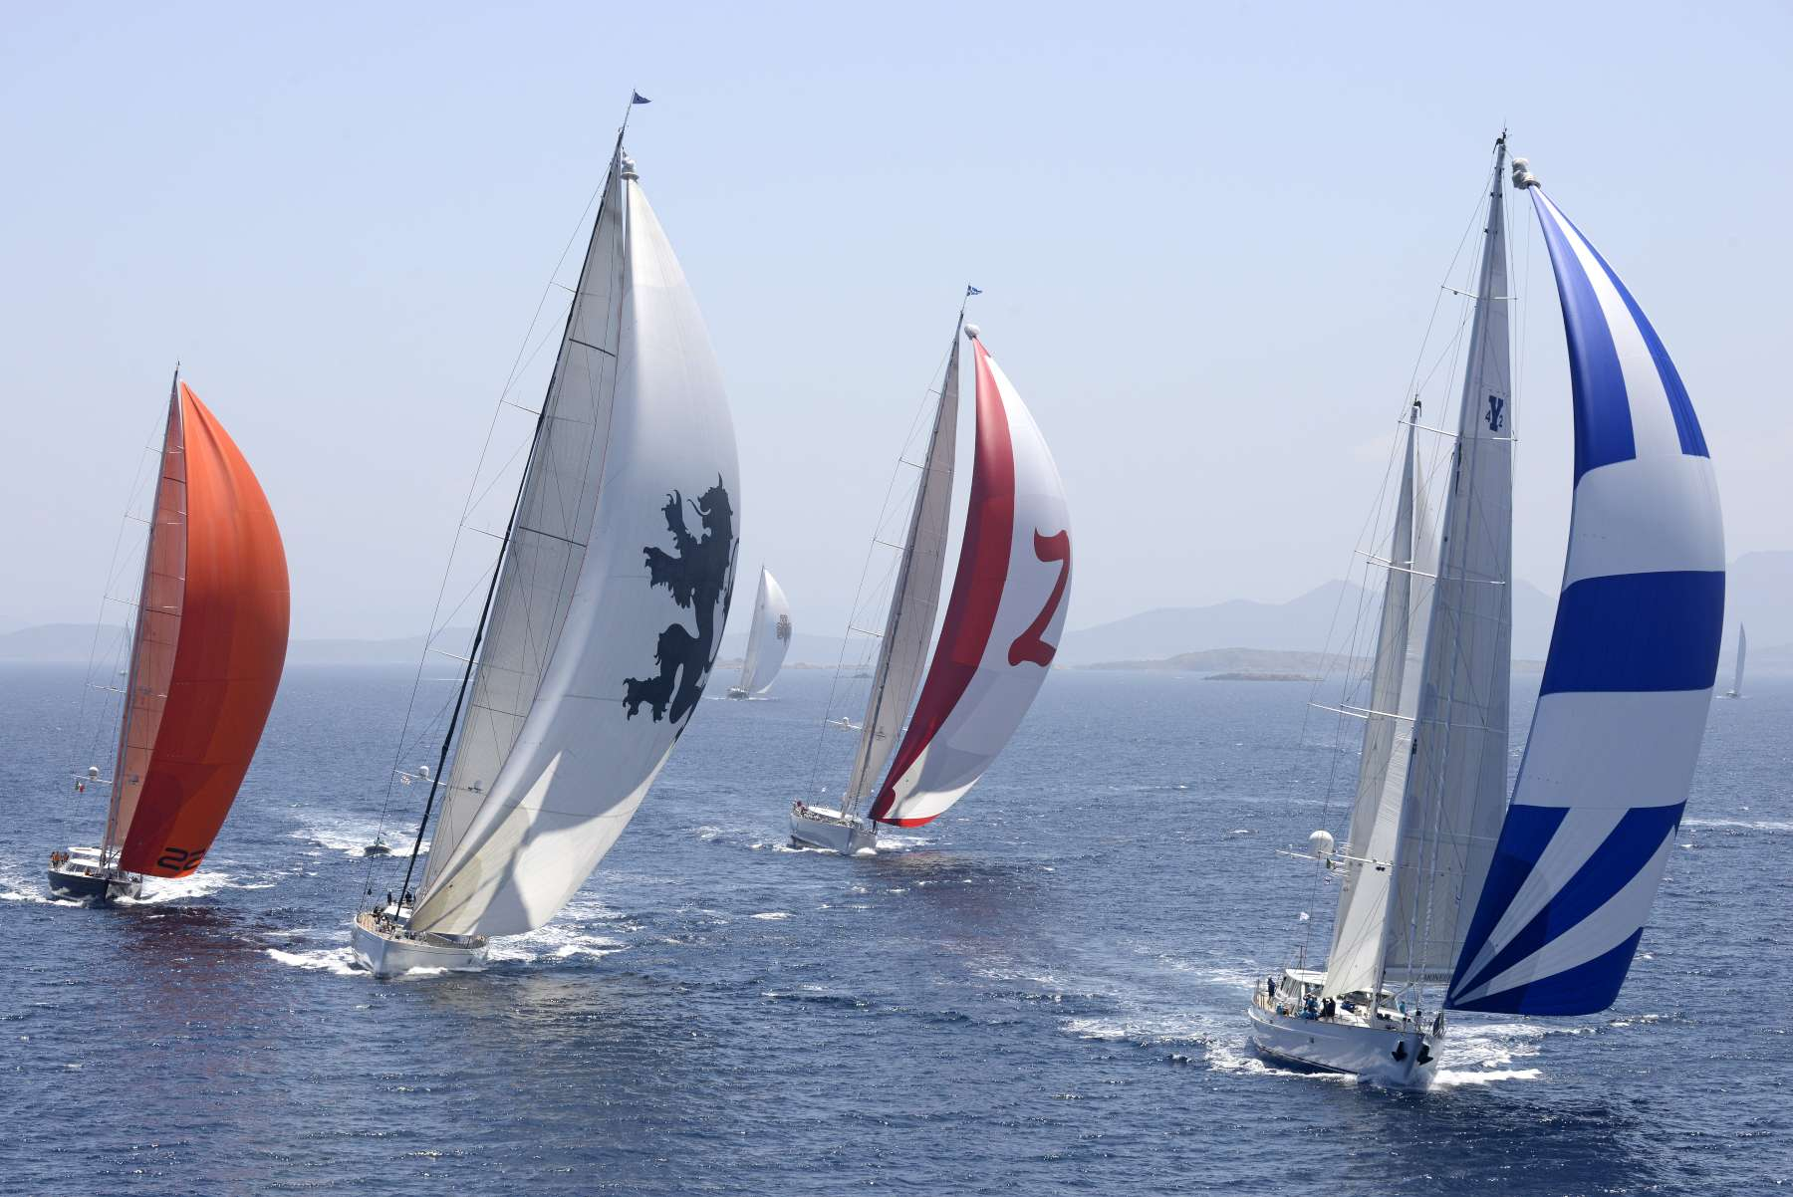
Introduction
Unmanned wind-powered autonomous surface vehicle (ASV)
Oceanographic research
Low-power Consumption
Introduction
Overview
Sailboat Simulation
Motion Control
Future Work

Slide 4
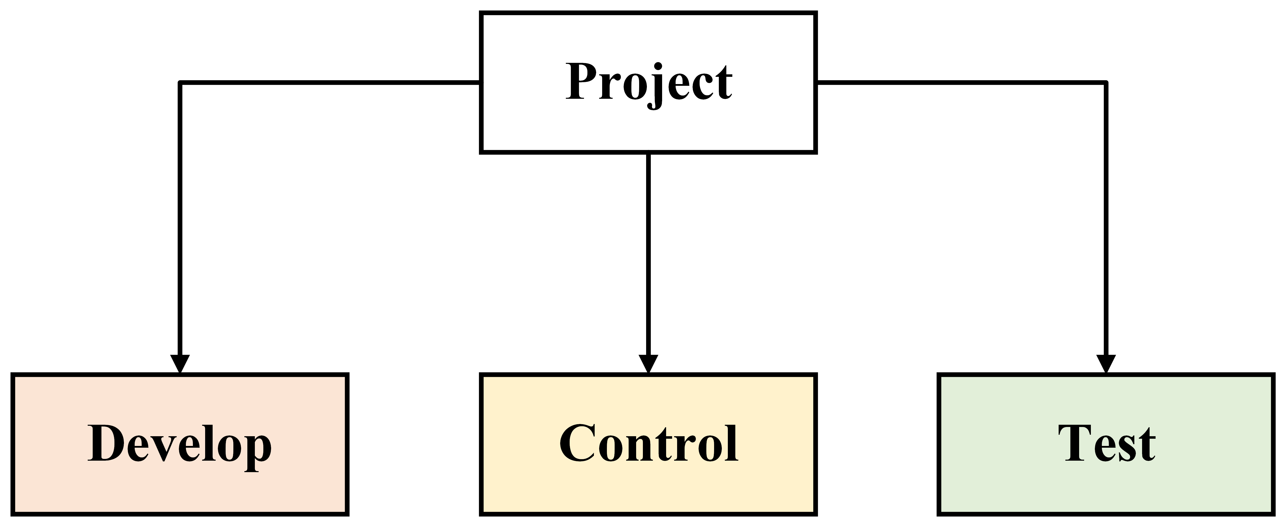
Overview
Research Goal: Develop a sailboat control system and platform capable of sailing a predefined course
Introduction
Overview
Sailboat Simulation
Motion Control
Future Work

Slide 5
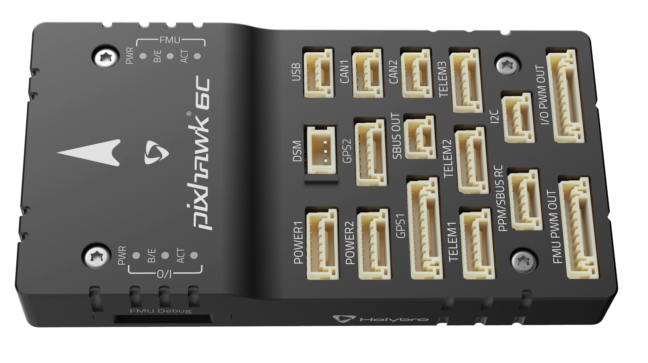

Overview: Develop
Shortage of simulators/control software platforms
Develop non-linear physics simulator of a sailboat with navigation and motion control systems in Simulink
Develop hardware platform to test control strategies
Developed the needed code to test and execute control systems on hardware
The hardware: Pixhawk 6C flight controller running Ardupilot’s Rover framework with a custom wind direction and speed sensor
Introduction
Overview
Sailboat Simulation
Motion Control
Future Work

Slide 6
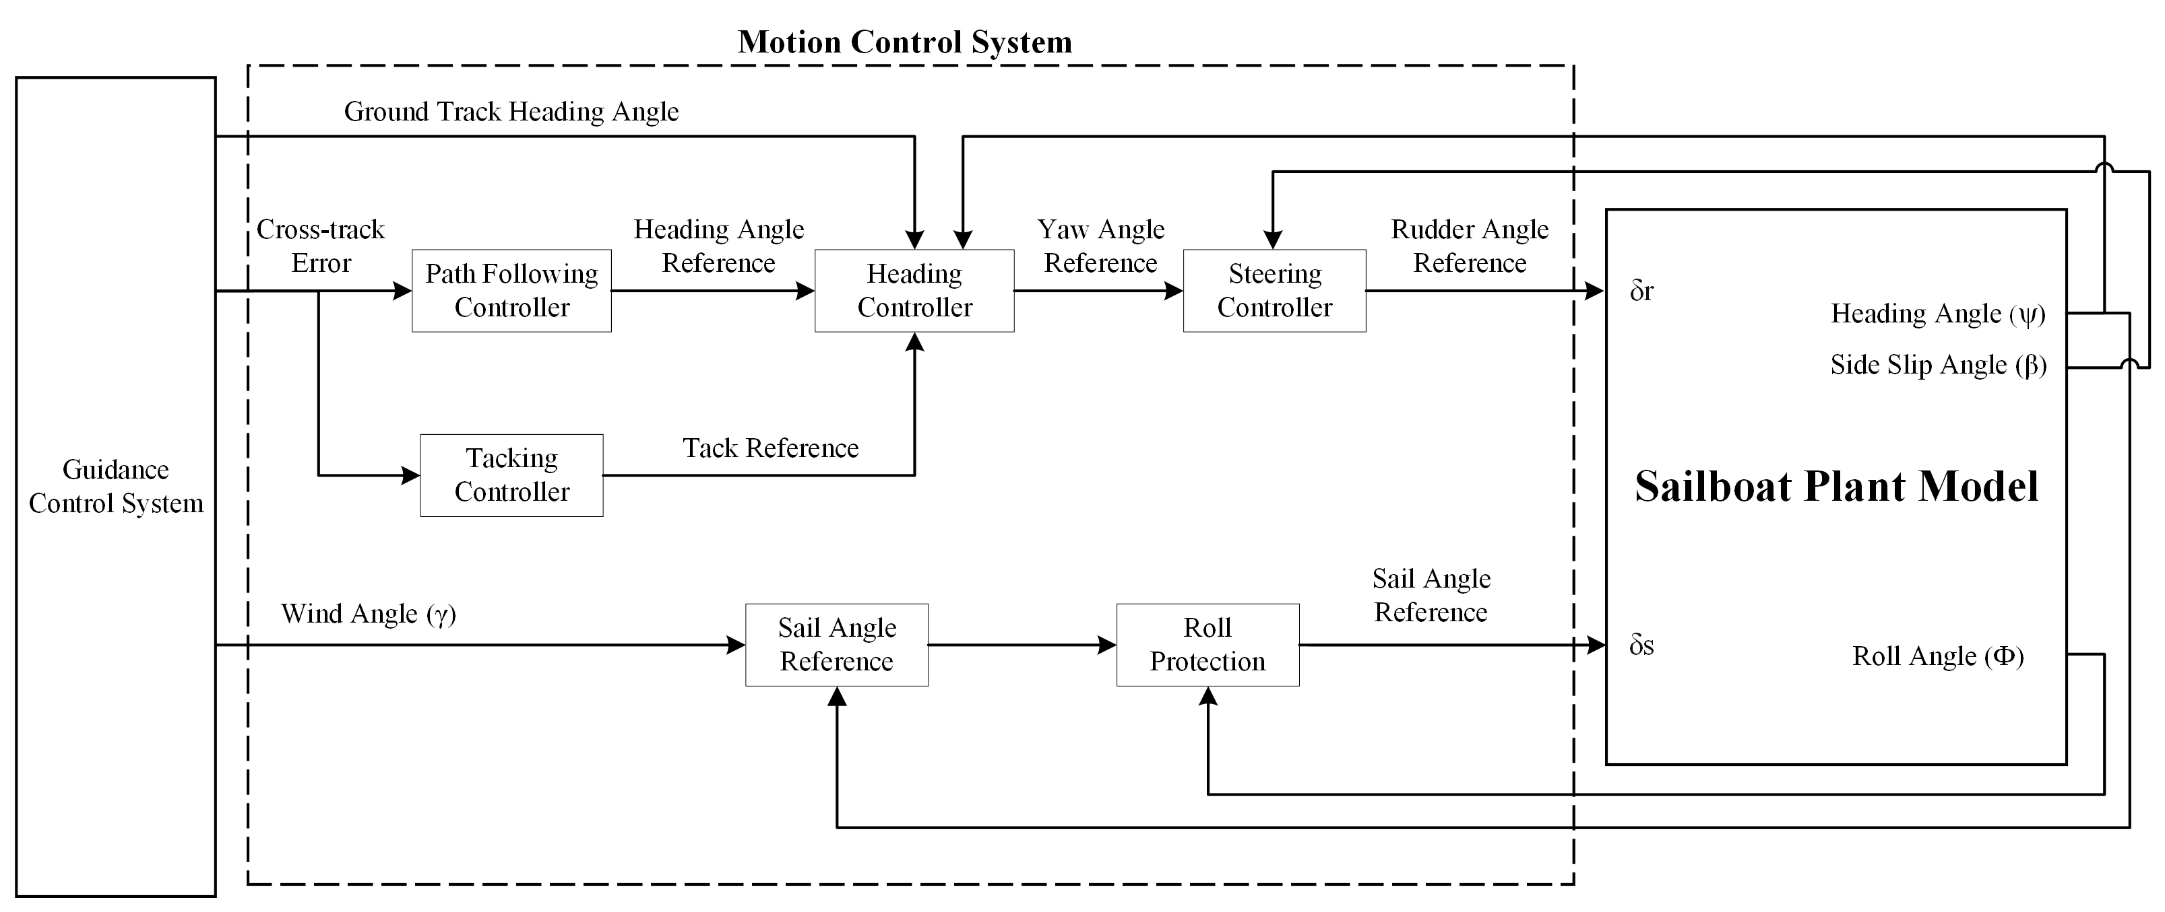
Overview: Control
Research and design navigation control systems
Research and design motion control systems capable of stabilizing, propelling and steering a sailboat
Develop multiple high level manoeuvring strategies
Introduction
Overview
Sailboat Simulation
Motion Control
Future Work

Slide 7
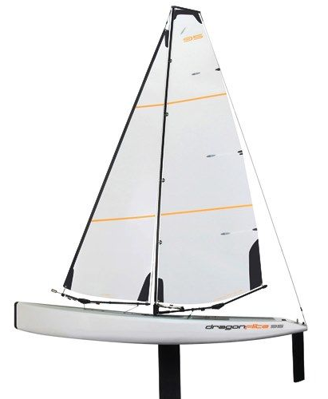
Overview: Test
Dragonflite 95 Sailboat, 1m long RC Sailboat
Lightweight and Durable hull
Two actuators (rudder & sail)
Establishing a testing pipeline
Simulink (Non-Linear)
Ardupilot’s SITL
Actual Sailboat
Introduction
Overview
Sailboat Simulation
Motion Control
Future Work

Slide 8
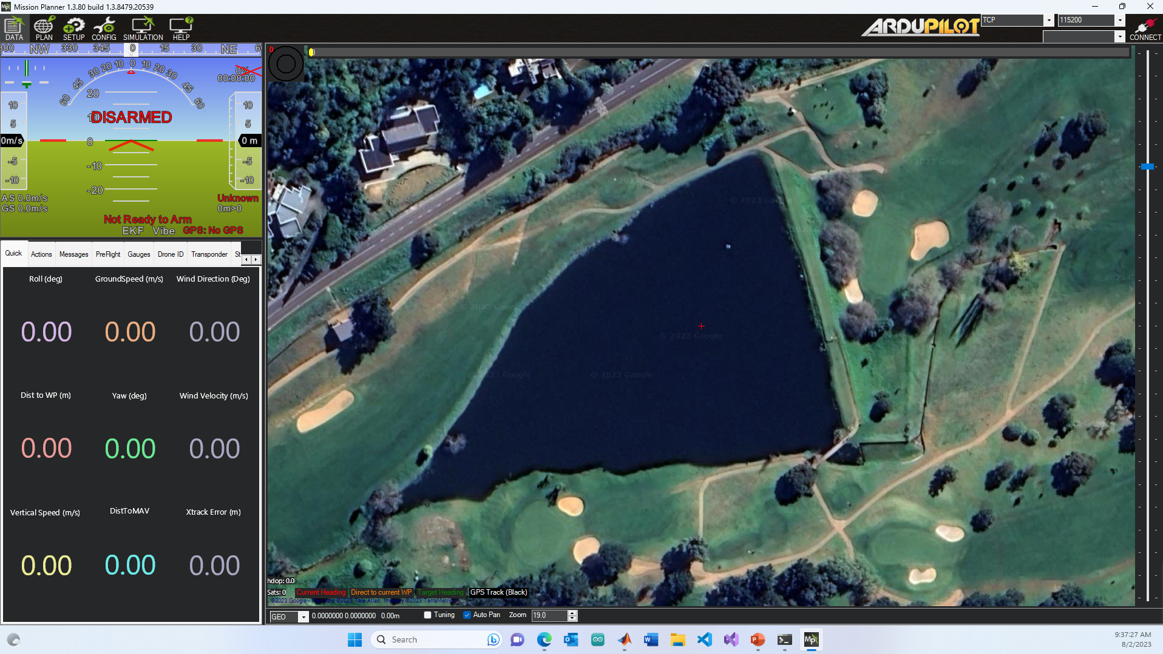
Overview: Control Platform
Mission Planner will be used as a control platform (built by Ardupilot)
Flash custom firmware to Pixhawk controller, test firmware in a SITL environment and monitor sailboat
Introduction
Overview
Sailboat Simulation
Motion Control
Future Work

Slide 9
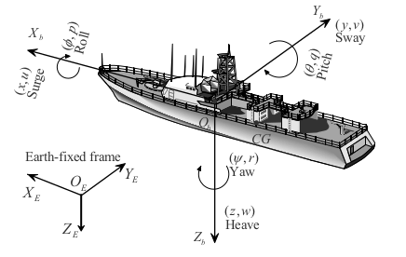
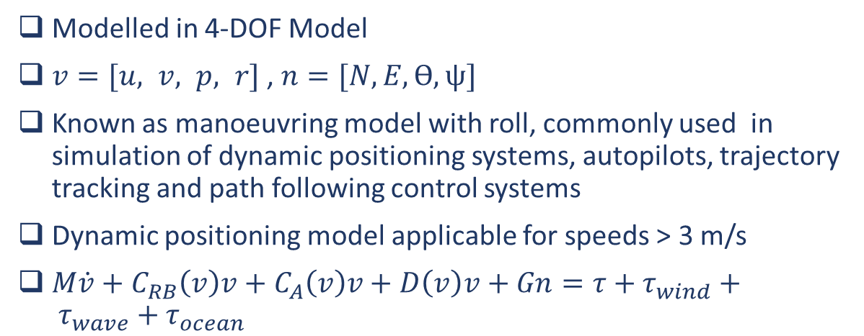
Sailboat Simulation
Modelled in 4-DOF Model
$v=[u, v, p, r]$ , $n=[N, E, ϴ, ψ]$
Known as manoeuvring model with roll, commonly used in simulation of dynamic positioning systems, autopilots, trajectory tracking and path following control systems
Dynamic positioning model applicable for speeds > 3 m/s
$M\dot{v}+C_{RB}\left(v\right)v+C_{A}\left(v\right)v+D\left(v\right)v+Gn=τ+τ_{wind}+ τ_{wave}+τ_{ocean}$
Introduction
Overview
Sailboat Simulation
Motion Control
Future Work
Notes:
V = velocity vector ,
N =position vector

Slide 10
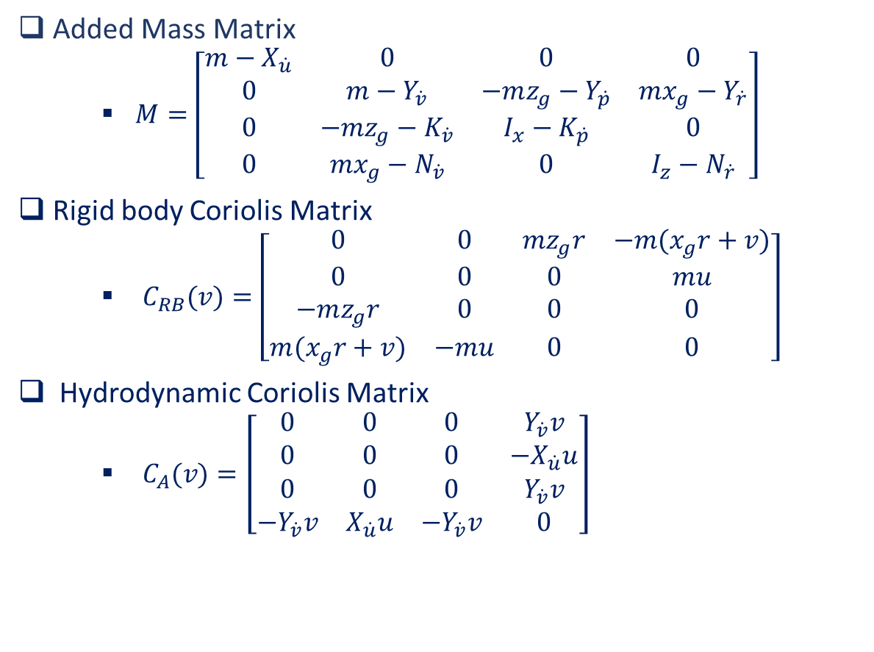
Sailboat Simulation
Added Mass Matrix
$M=\left[\begin{matrix}m−X_{\dot{u}} & 0 & 0 & 0 \\ 0 & m−Y_{\dot{v}} & −mz_{g}−Y_{\dot{p}} & mx_{g}−Y_{\dot{r}} \\ 0 & −mz_{g}−K_{\dot{v}} & I_{x}−K_{\dot{p}} & 0 \\ 0 & mx_{g}−N_{\dot{v}} & 0 & I_{z}−N_{\dot{r}}\end{matrix}\right]$
Rigid body Coriolis Matrix
$C_{RB}(v)=\left[\begin{matrix}0 & 0 & mz_{g}r & −m(x_{g}r+v) \\ 0 & 0 & 0 & mu \\ −mz_{g}r & 0 & 0 & 0 \\ m(x_{g}r+v) & −mu & 0 & 0\end{matrix}\right]$
Hydrodynamic Coriolis Matrix
$C_{A}(v)=\left[\begin{matrix}0 & 0 & 0 & Y_{\dot{v}}v \\ 0 & 0 & 0 & −X_{\dot{u}}u \\ 0 & 0 & 0 & Y_{\dot{v}}v \\ −Y_{\dot{v}}v & X_{\dot{u}}u & −Y_{\dot{v}}v & 0\end{matrix}\right]$
Introduction
Overview
Sailboat Simulation
Motion Control
Future Work

Slide 11
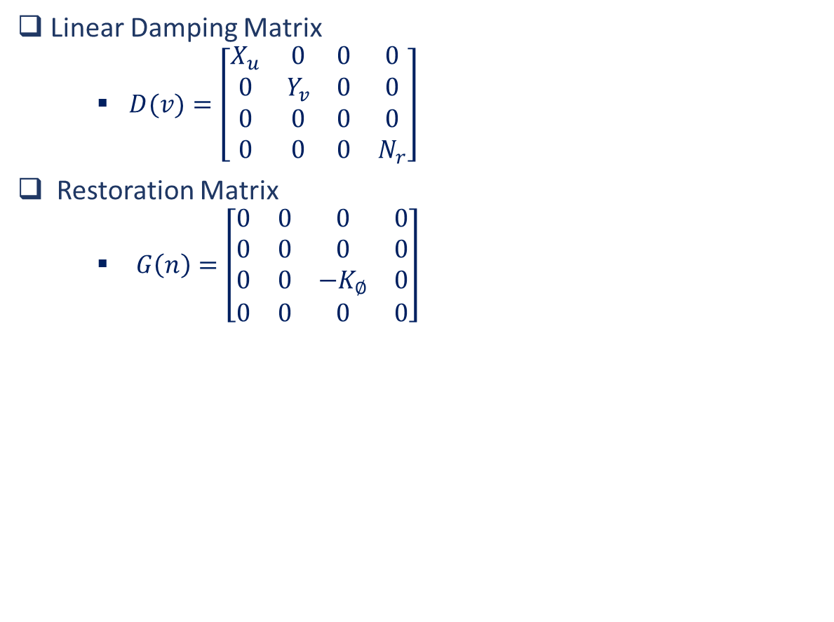
Sailboat Simulation
Linear Damping Matrix
$D(v)=\left[\begin{matrix}X_{u} & 0 & 0 & 0 \\ 0 & Y_{v} & 0 & 0 \\ 0 & 0 & 0 & 0 \\ 0 & 0 & 0 & N_{r}\end{matrix}\right]$
Restoration Matrix
$G\left(n\right)=\left[\begin{matrix}0 & 0 & 0 & 0 \\ 0 & 0 & 0 & 0 \\ 0 & 0 & −K_{∅} & 0 \\ 0 & 0 & 0 & 0\end{matrix}\right]$
Introduction
Overview
Sailboat Simulation
Motion Control
Future Work

Slide 12
Sailboat Simulation
Assumptions
The sailboat is assumed to be rigid with 4-DOF: surge, sway, roll and yaw motions
The sails are combined into one effective sail area
The sail, keel and rudder is modelled as rigid foils and computed independently
Friction forces are considered as linear damping elements
Added mass and Coriolis coefficients are modelled as constants
Environmental forces are modelled
Servo motor delays for the sail and rudder is modelled
Environmental Forces
Waves
Wind
Ocean Currents
Introduction
Overview
Sailboat Simulation
Motion Control
Future Work
[Modeling and Nonlinear Heading Control for Sailing Yachts, L. Xiao and J. Jouffroy]

Slide 13
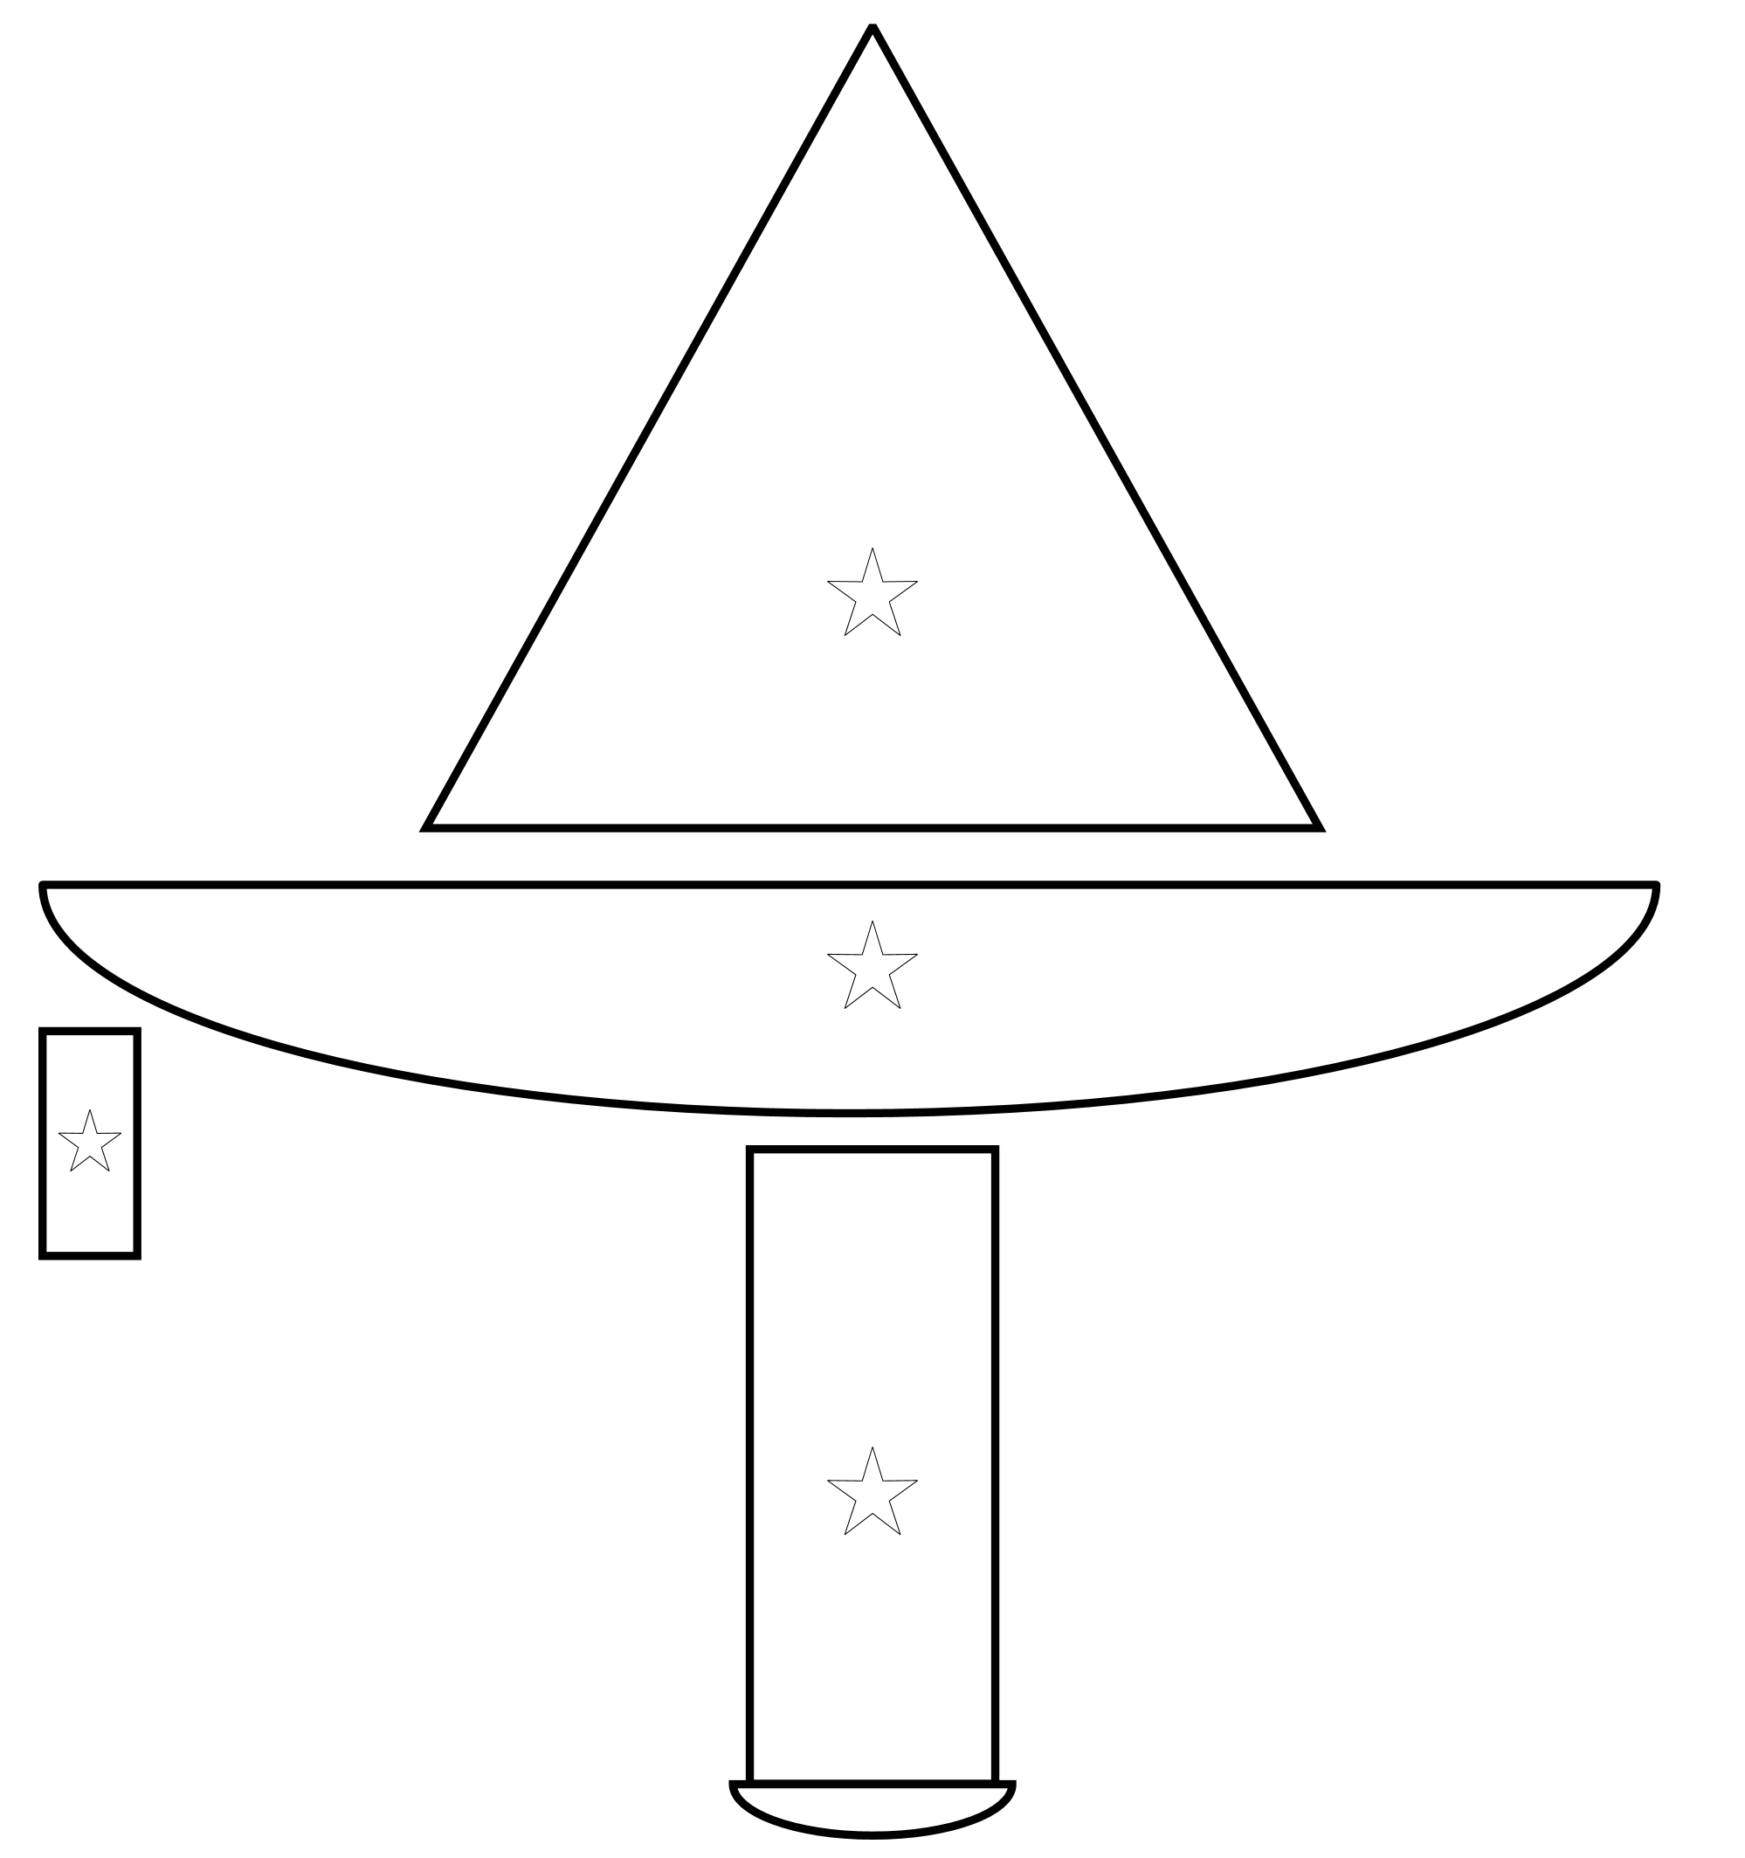
Sailboat Simulation
Introduction
Overview
Sailboat Simulation
Motion Control
Future Work
Sail
Hull
Rudder
Keel

Slide 14
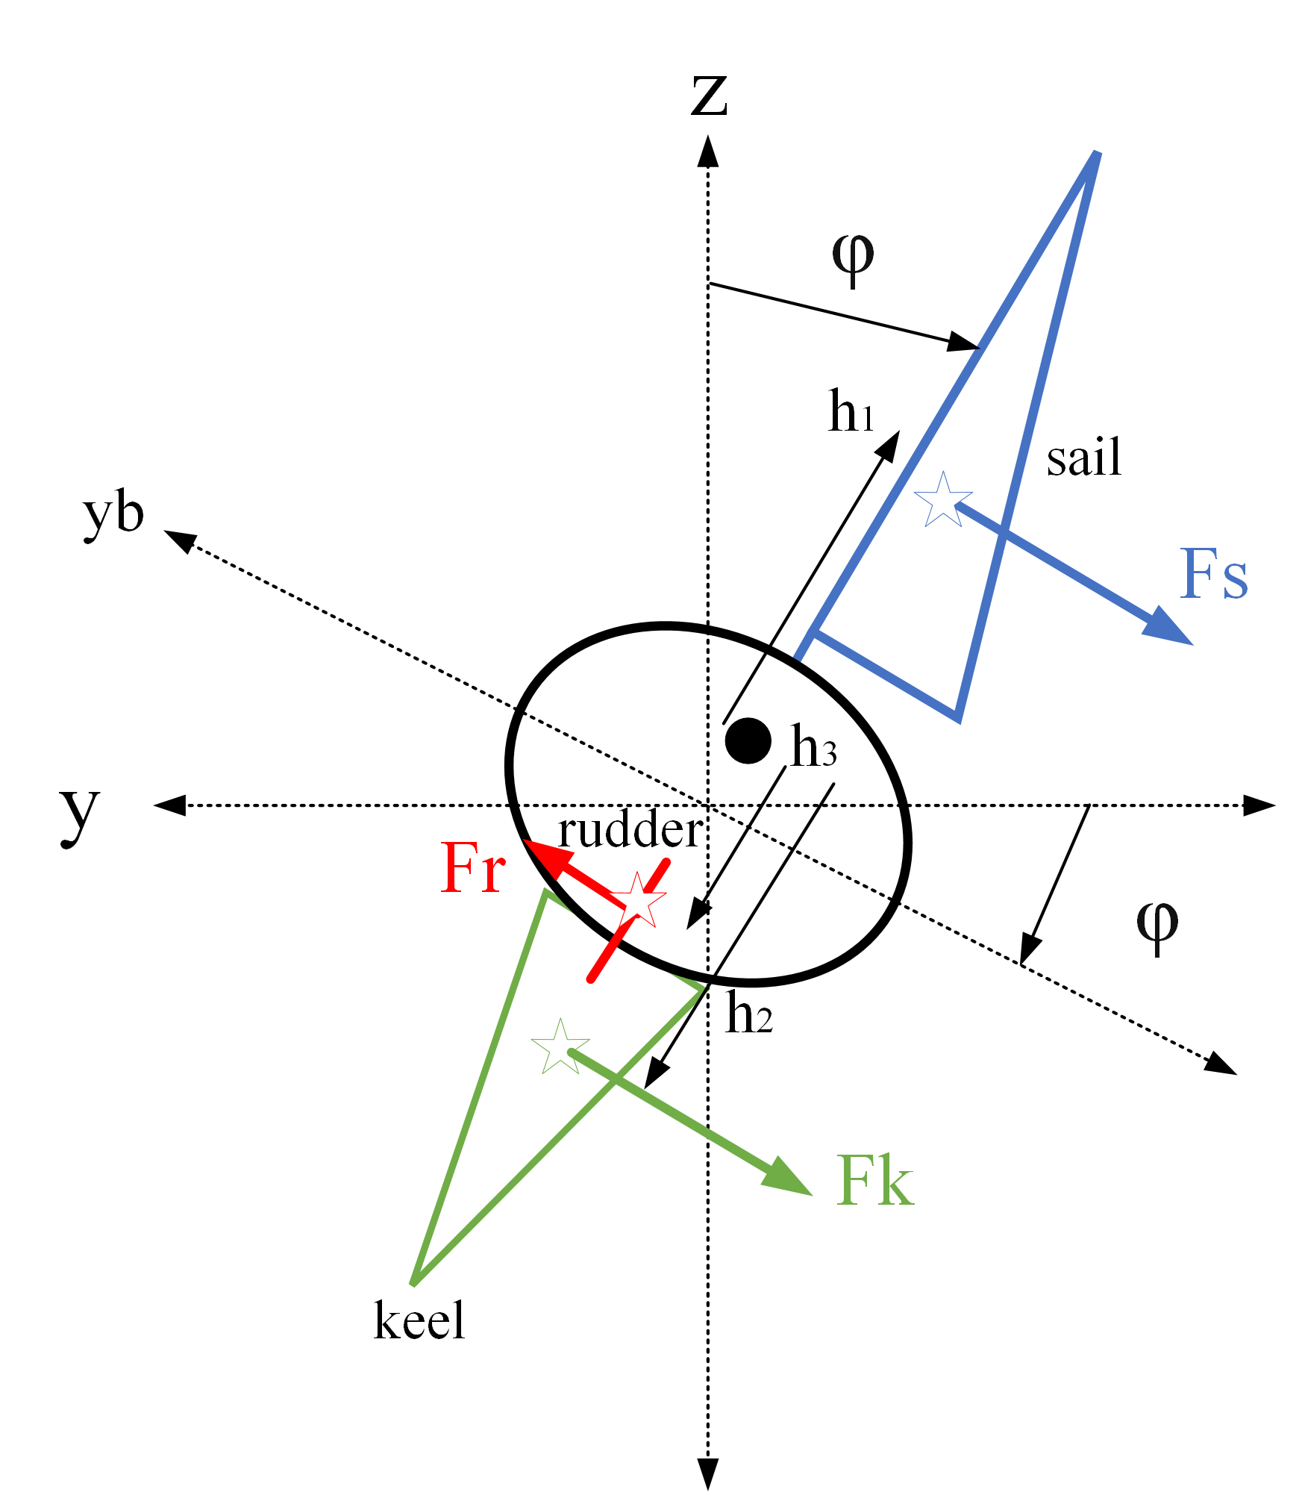
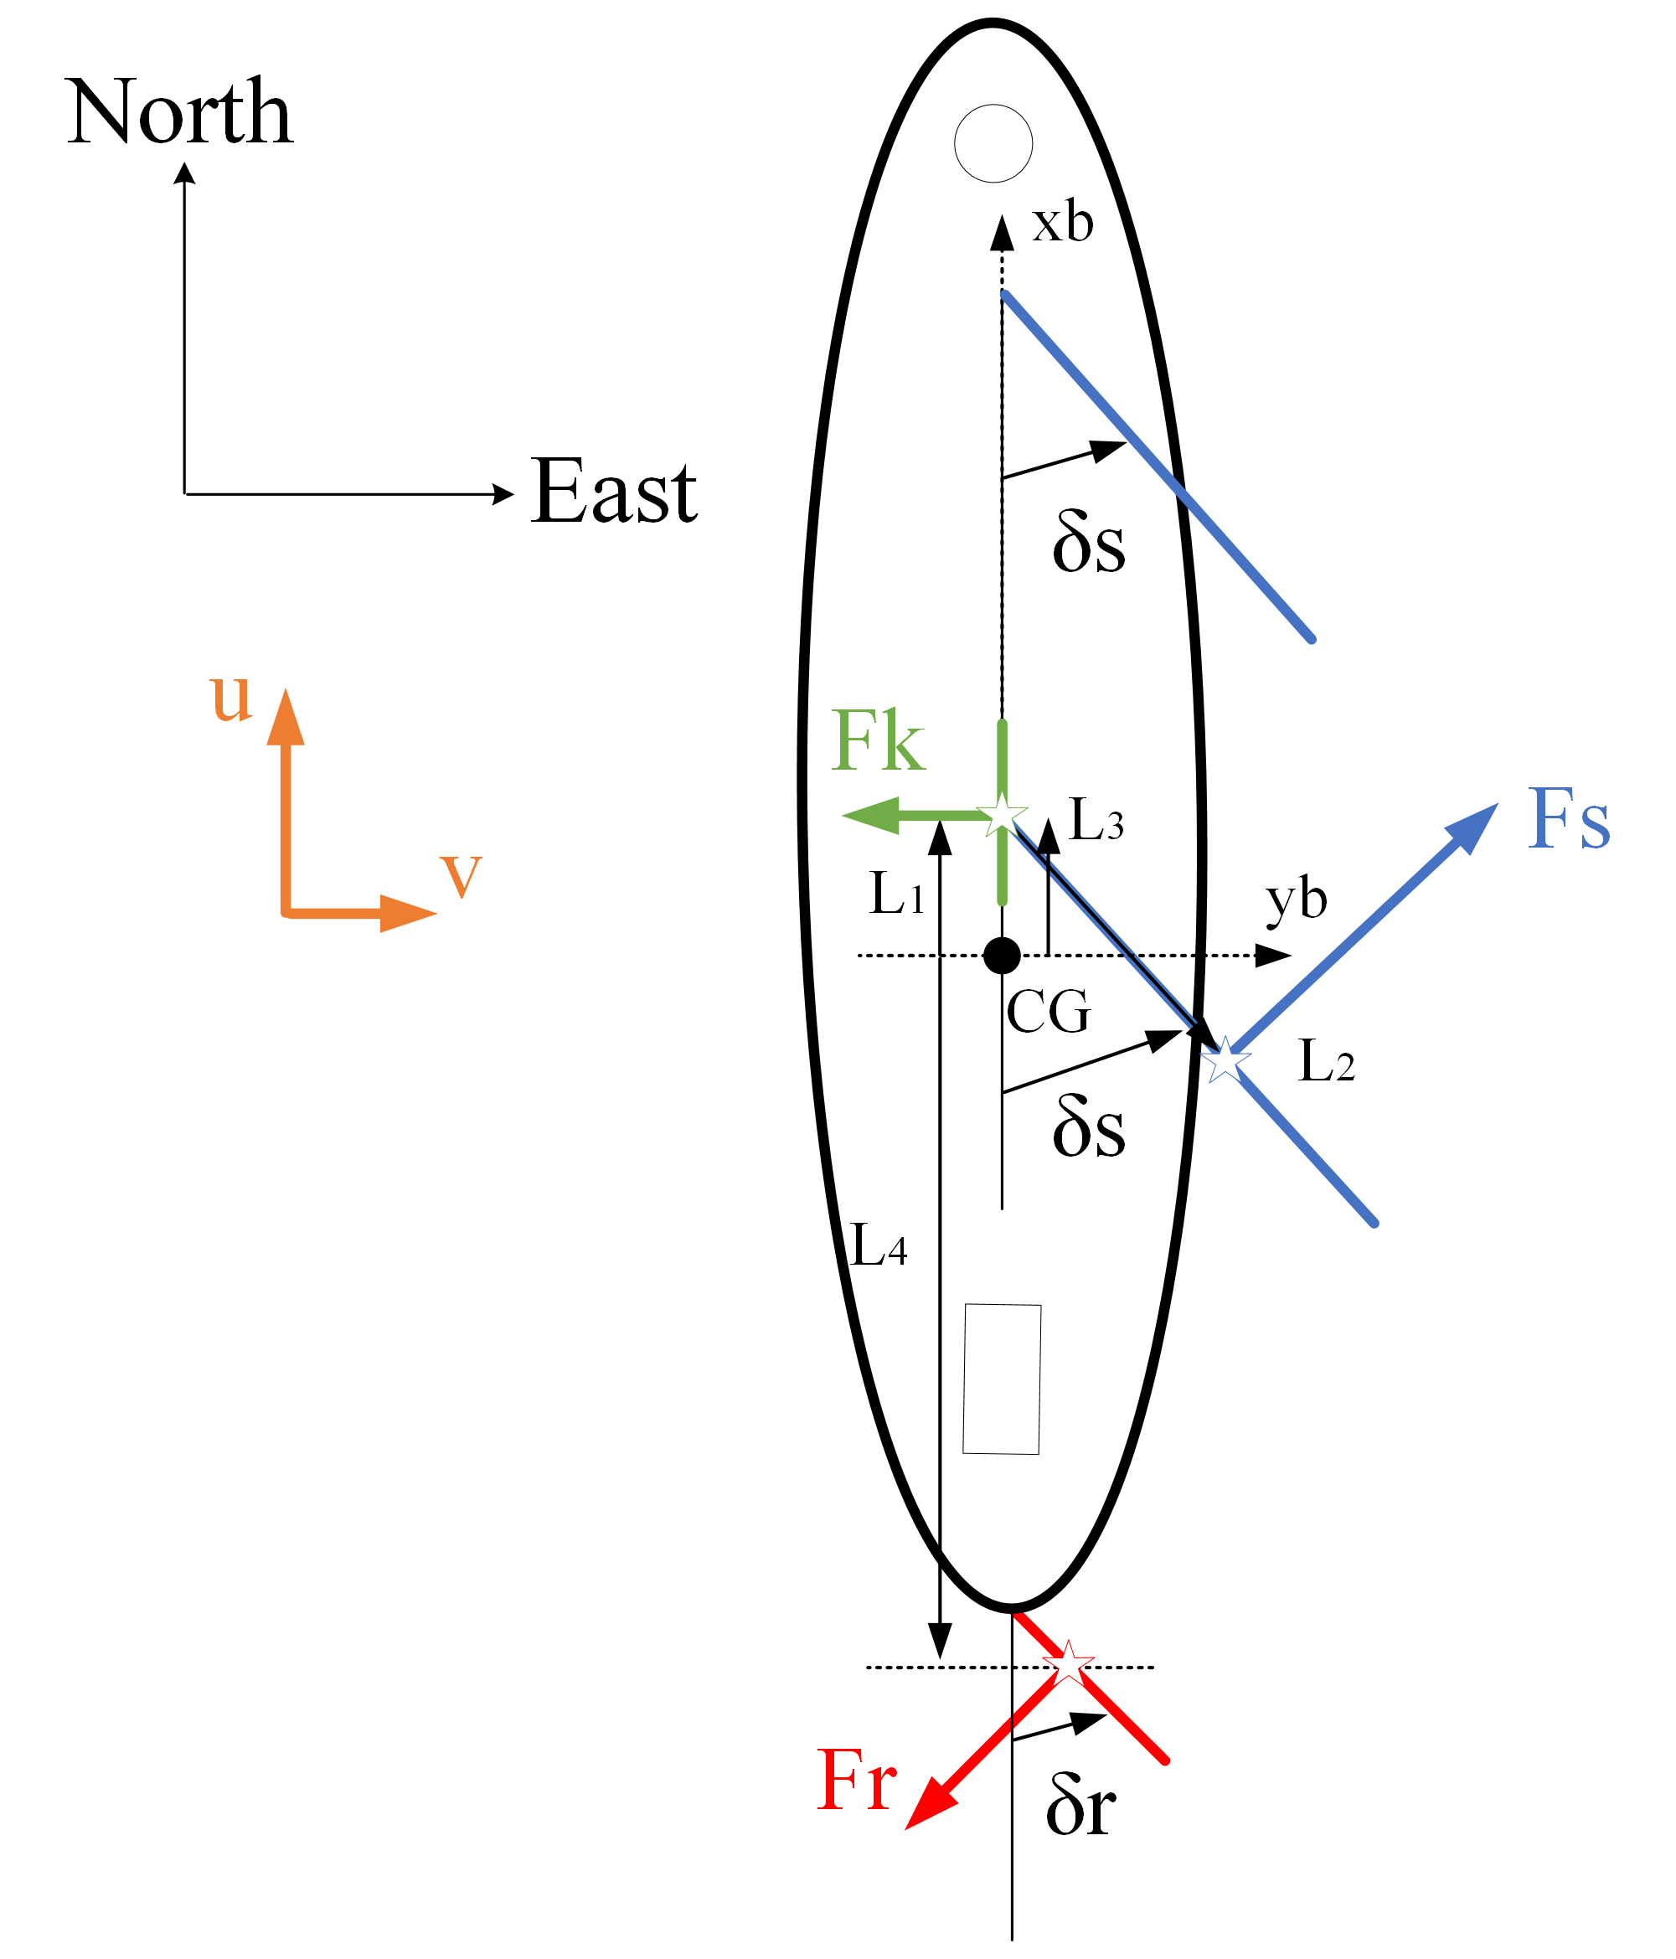
Sailboat Simulation
Introduction
Overview
Sailboat Simulation
Motion Control
Future Work

Slide 15
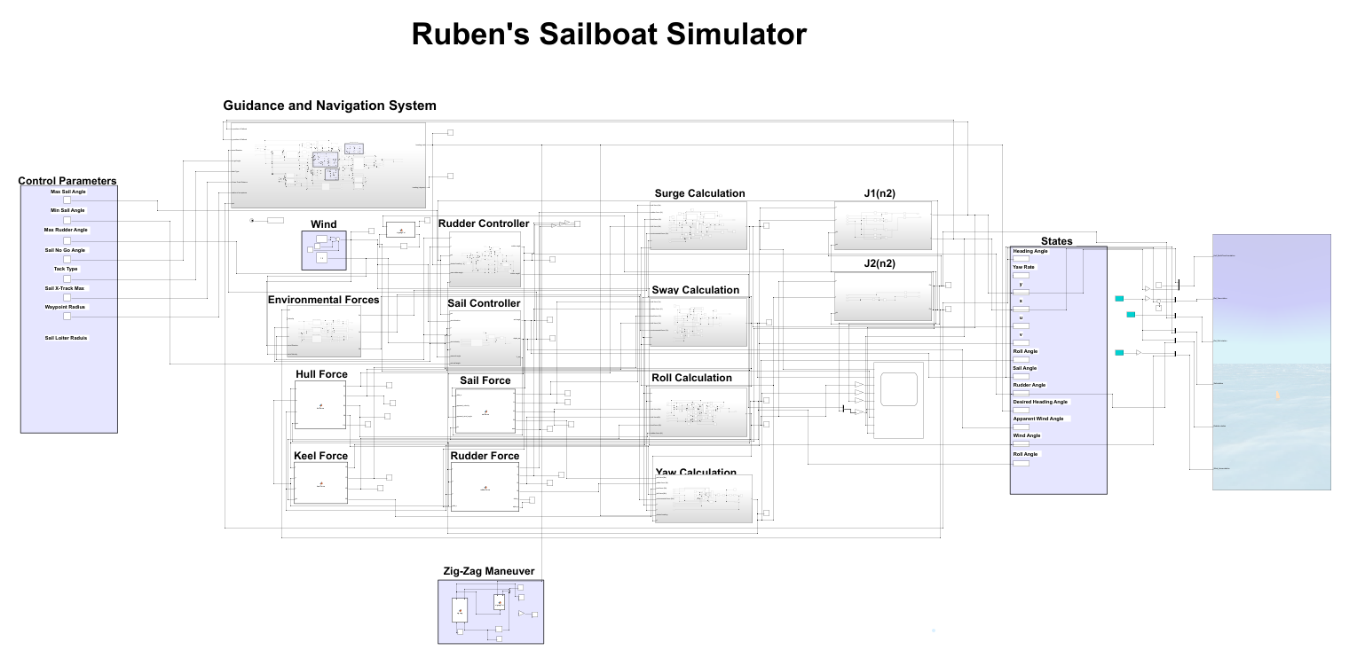
Sailboat Simulation
Introduction
Overview
Sailboat Simulation
Motion Control
Future Work

Slide 16
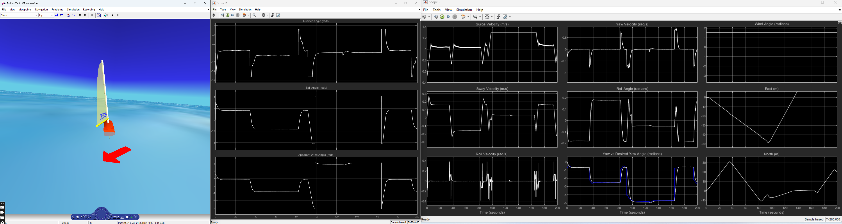
Sailboat Simulation
Introduction
Overview
Sailboat Simulation
Motion Control
Future Work

Slide 17
Motion Control System
Motion control system tasks consist of making a ship follow a desired trajectory, which is defined in terms of a ship’s position, velocity and acceleration
Introduction
Overview
Sailboat Simulation
Motion Control
Future Work

Slide 18
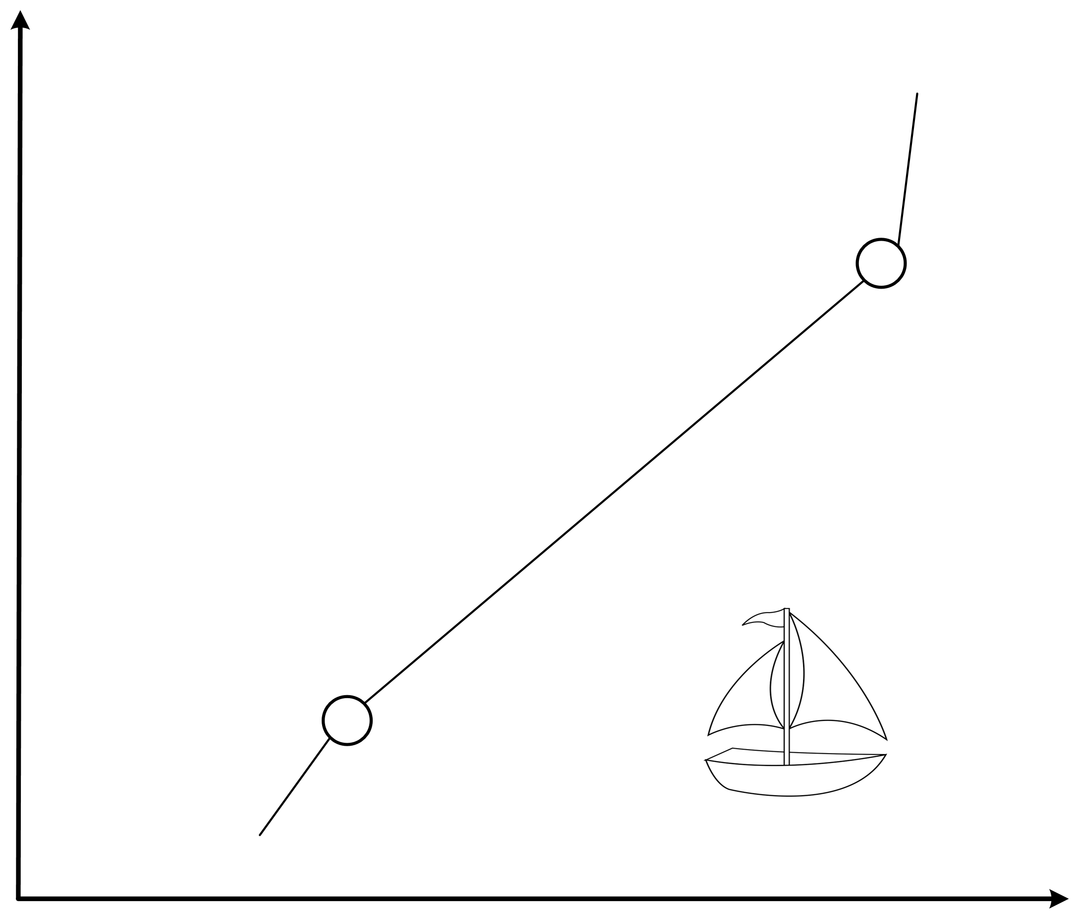
Motion Control System
Introduction
Overview
Sailboat Simulation
Motion Control
Future Work
N
Wind Direction (North-to-South)
Destination waypoint
(Ed, Nd)
ground track heading angle
Cross-track
(Es, Ns)
Source waypoint
(E, N)
E

Slide 19
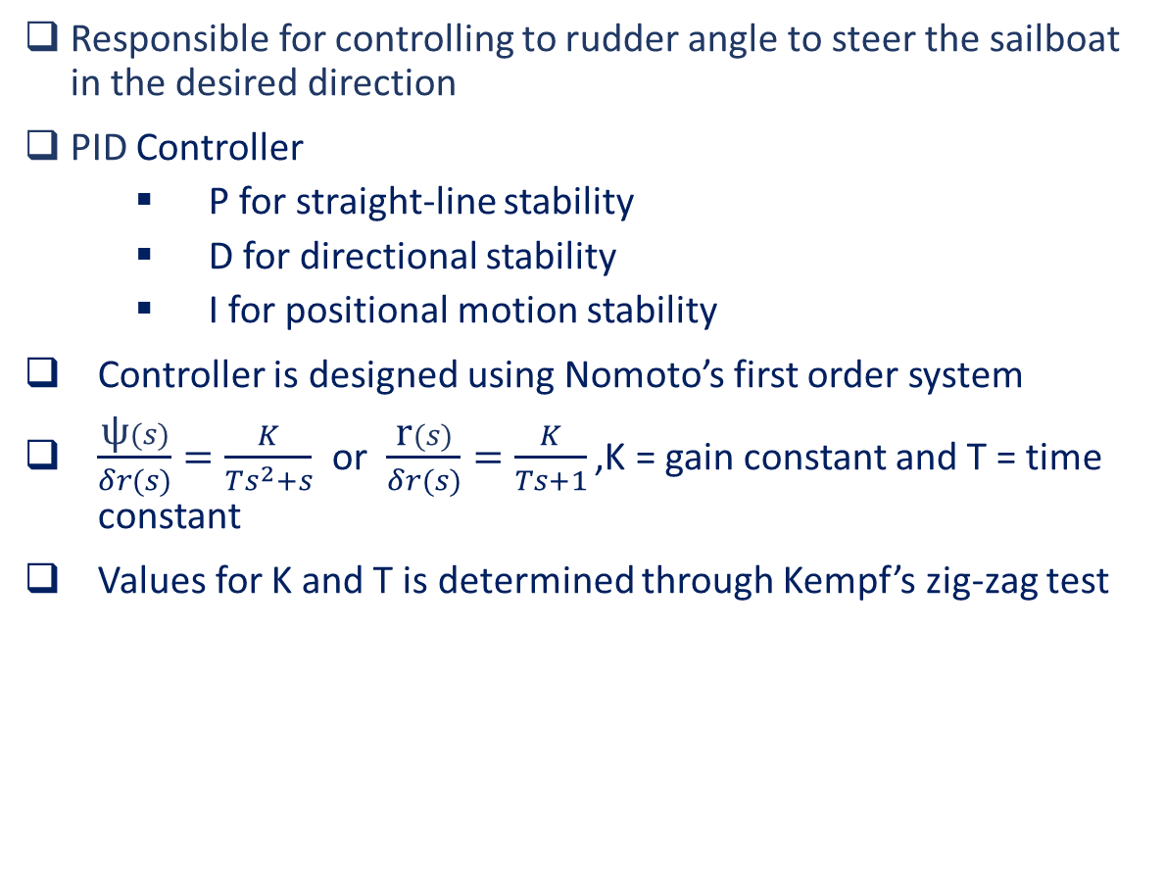
Motion Control: Steering Controller
Responsible for controlling to rudder angle to steer the sailboat in the desired direction
PID Controller
P for straight-line stability
D for directional stability
I for positional motion stability
Controller is designed using Nomoto’s first order system
$\frac{\text{ψ}(s)}{δr(s)}=\frac{K}{Ts^{2}+s}$ or $\frac{\text{r}(s)}{δr(s)}=\frac{K}{Ts+1}$ ,K = gain constant and T = time constant
Values for K and T is determined through Kempf’s zig-zag test
Introduction
Overview
Sailboat Simulation
Motion Control
Future Work
Notes:
Straight-Line stability: If new path is straight after a disturbance in yaw the craft is said to have straight-line stability. Uncontrolled vessels new path will differ from initial path due to no restoring forces
Directional Stability: Direction stability requires the final path to be parallel to the initial path that is obtained
Positional Motion Stability: Position Motion Stability implies that the vessel should return to its original path after its disturbance
Xd = course angle to psi_d the heading angle with the knowledge of beta

Slide 20
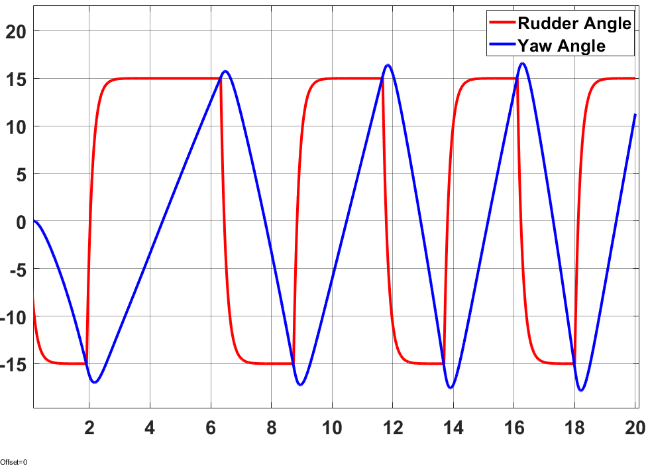
Motion Control: Steering Controller
Zig-Zag Test
K = 2.6005 & T = 0.4364
Introduction
Overview
Sailboat Simulation
Motion Control
Future Work

Slide 21
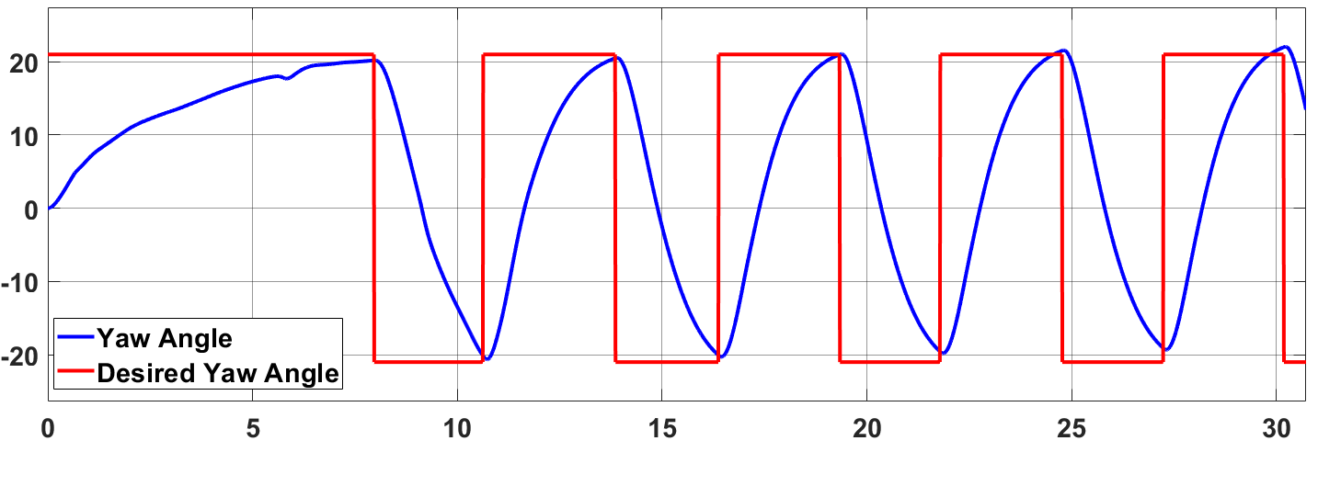
Motion Control: Steering Controller
Flipping zig-zag test, switching between a 20- and -20-degrees yaw angle
Introduction
Overview
Sailboat Simulation
Motion Control
Future Work

Slide 22
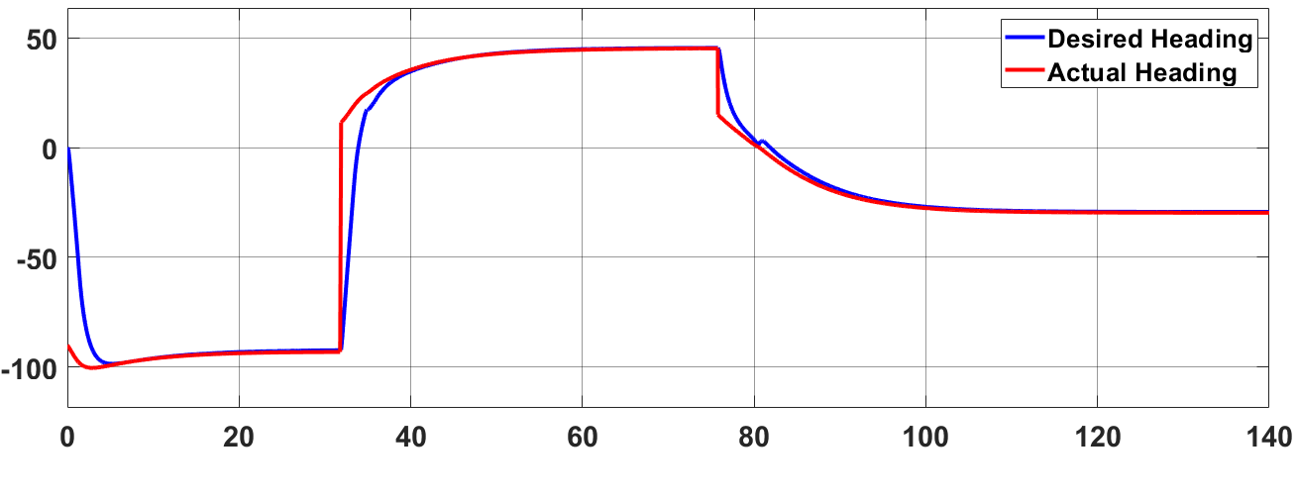
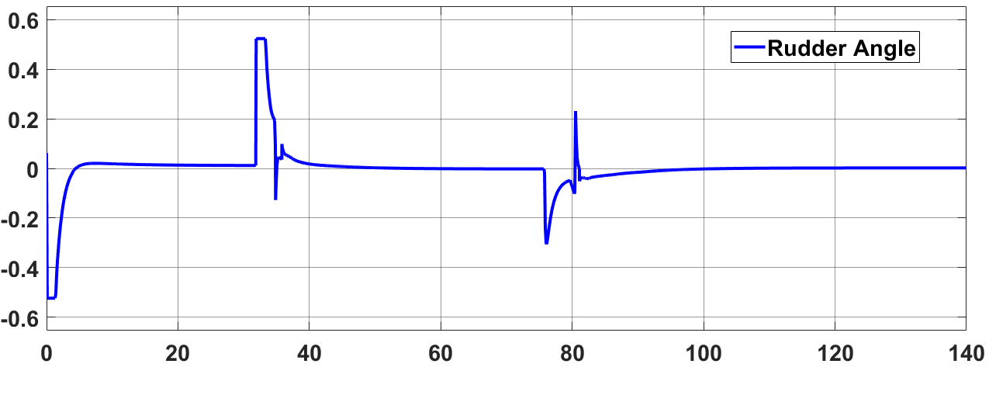
Motion Control: Steering Controller
Introduction
Overview
Sailboat Simulation
Motion Control
Future Work

Slide 23
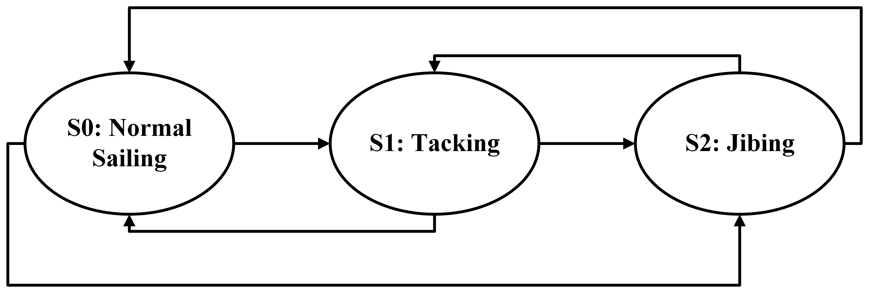
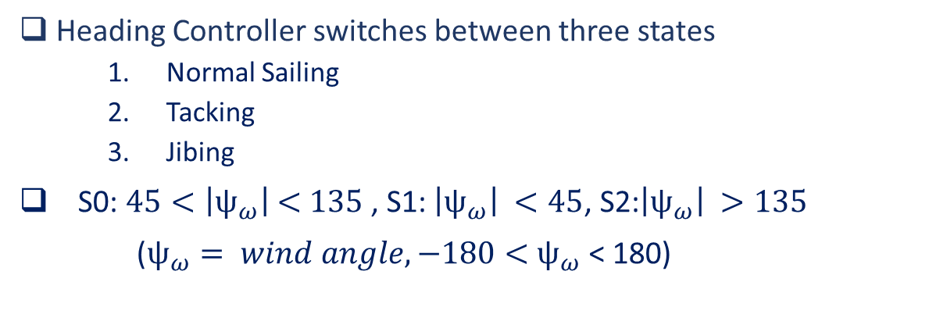
Motion Control: Heading Controller
Heading Controller switches between three states
Normal Sailing
Tacking
Jibing
S0: $45{<\left|ψ_{ω}\right|}_{ }<135$ , S1:${\left|ψ_{ω}\right|}_{ }<45$, S2:${\left|ψ_{ω}\right|}_{ }>135$
($ψ_{ω}= wind angle, −180<$ $ψ_{ω}$ < 180)
Introduction
Overview
Sailboat Simulation
Motion Control
Future Work

Slide 24
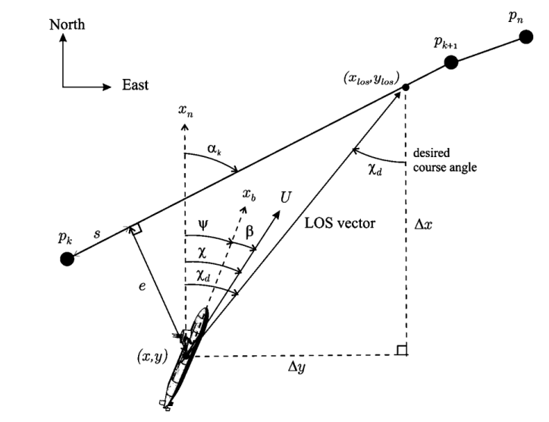
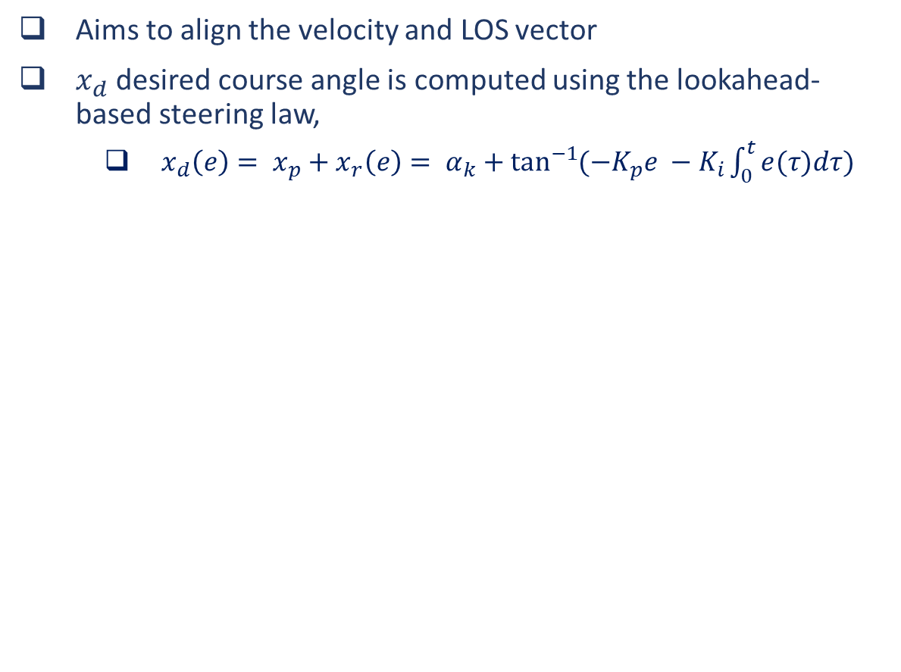
Motion Control: Path Following Controller
Aims to align the velocity and LOS vector
$x_{d}$ desired course angle is computed using the lookahead-based steering law,
$x_{d}\left(e\right)= x_{p}+x_{r}\left(e\right)= α_{k}+\tan^{−1}{(−K_{p}e −K_{i}\int_{0}^{t}{e(τ)dτ})}$
Introduction
Overview
Sailboat Simulation
Motion Control
Future Work

Slide 25
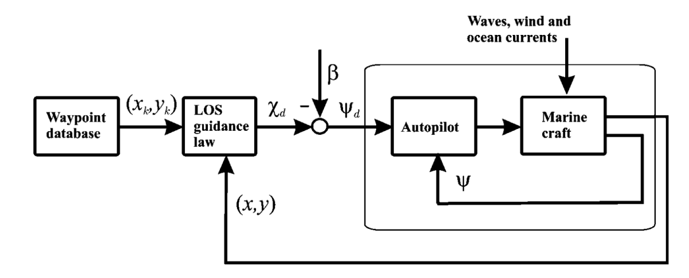
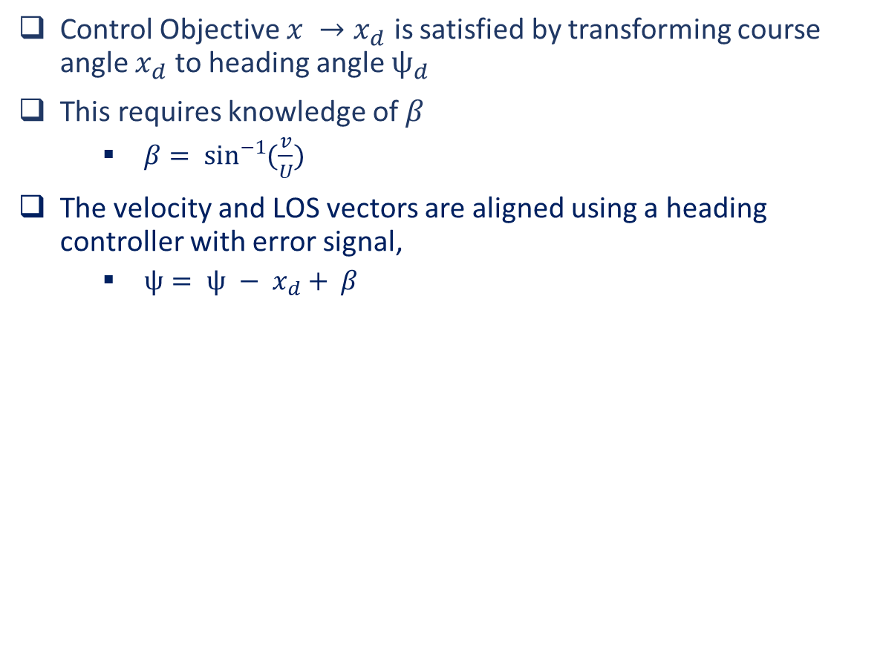
Motion Control: Path Following Controller
Control Objective $x →x_{d}$ is satisfied by transforming course angle $x_{d}$ to heading angle $ψ_{d}$
This requires knowledge of $β$
$β= \sin^{−1}{(\frac{v}{U})}$
The velocity and LOS vectors are aligned using a heading controller with error signal,
$ψ= ψ − x_{d}+ β$
Introduction
Overview
Sailboat Simulation
Motion Control
Future Work

Slide 26
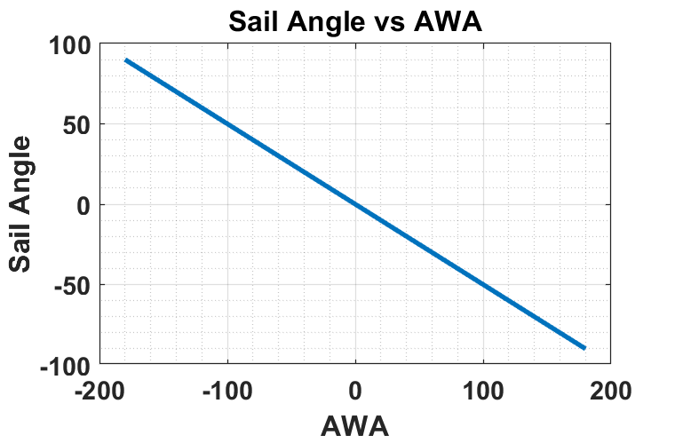
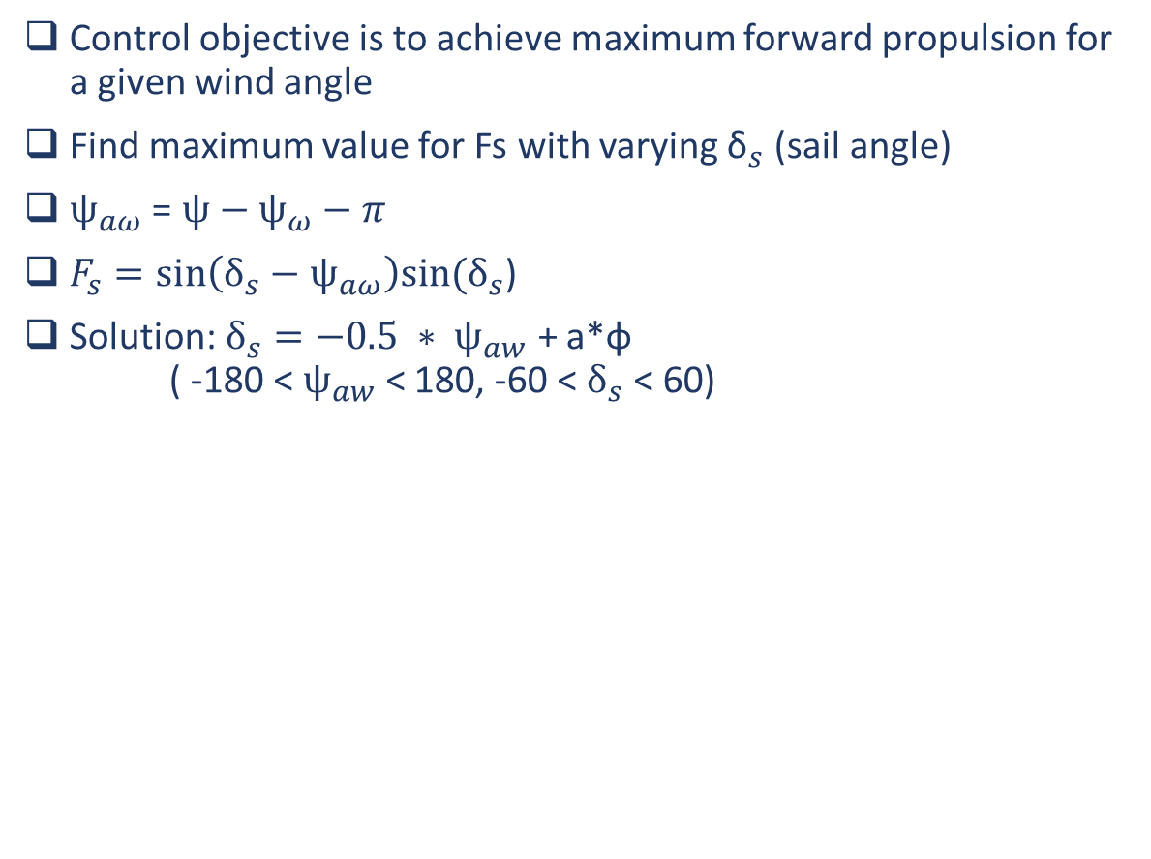
Motion Control: Sail Angle Reference
Control objective is to achieve maximum forward propulsion for a given wind angle
Find maximum value for Fs with varying ${\text{δ}}_{s}$ (sail angle)
${\text{ψ}}_{aω}$ = $\text{ψ}\text{ − }{\text{ψ}}_{ω}−π$
$F_{s}=sin\left(δ_{s}−{\text{ψ}}_{aω}\right)sin⁡(δ_{s}$)
Solution: $δ_{s}=−0.5 ∗ {\text{ψ}}_{aw}$ + a*φ ( -180 < ${\text{ψ}}_{aw}$ < 180, -60 < $δ_{s}$ < 60)
Introduction
Overview
Sailboat Simulation
Motion Control
Future Work

Slide 27
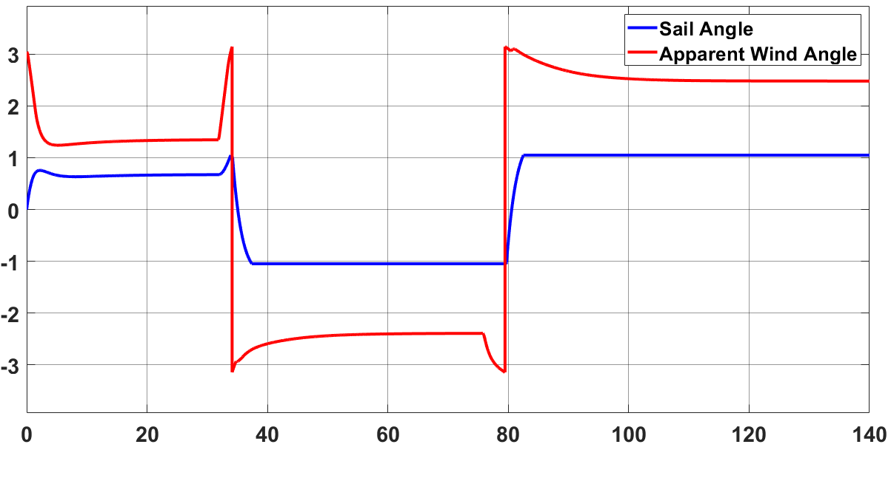
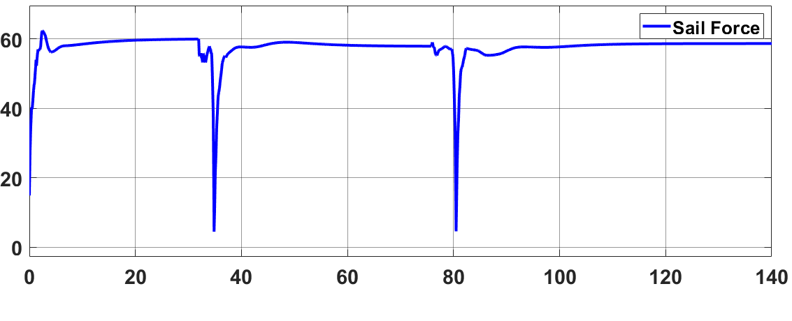
Motion Control: Sail Angle Reference
Introduction
Overview
Sailboat Physics
Motion Control
Future Work

Slide 28
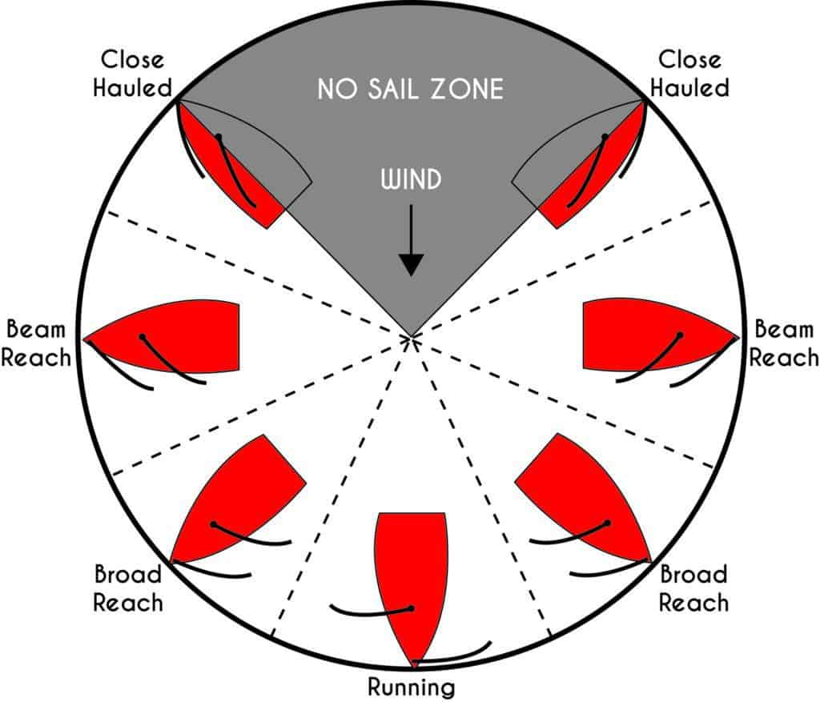
Motion Control: Tacking Controller
Required to sail into the wind
3 Tacking Controllers
Direct Tack
Indirect Tack
Zone Tacking
Tacking Controller feeds heading angle into Heading Controller
Introduction
Overview
Sailboat Simulation
Motion Control
Future Work

Slide 29
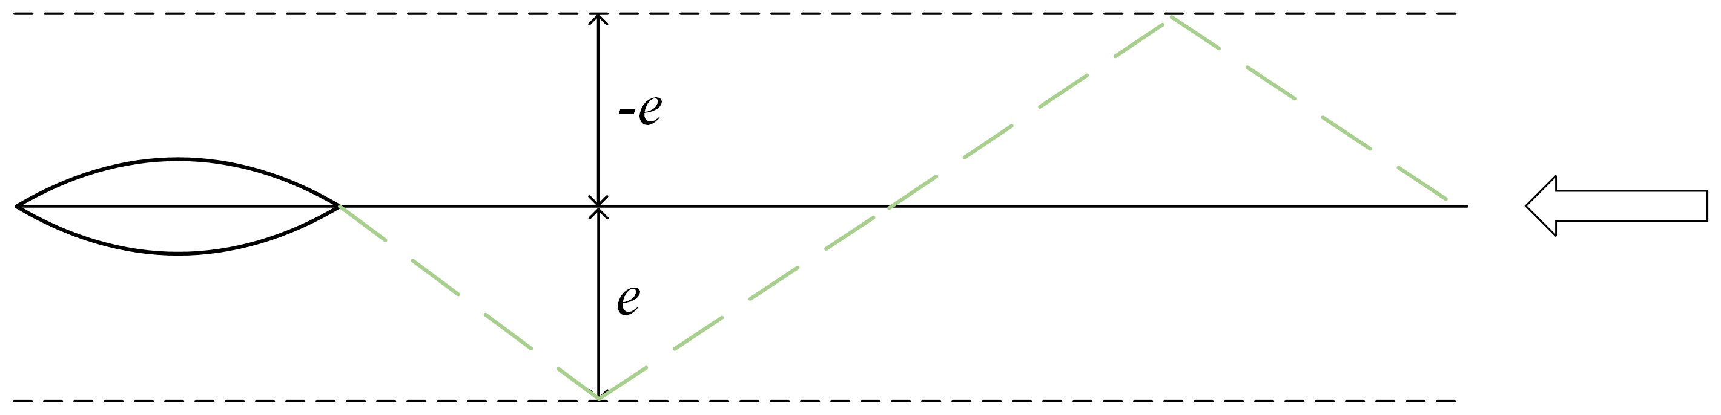
Motion Control: Direct Tack
Direct Tack is defined as a tack maneuver were the cross-track error determines what side the sailboat should tack
Introduction
Overview
Sailboat Simulation
Motion Control
Future Work

Slide 30
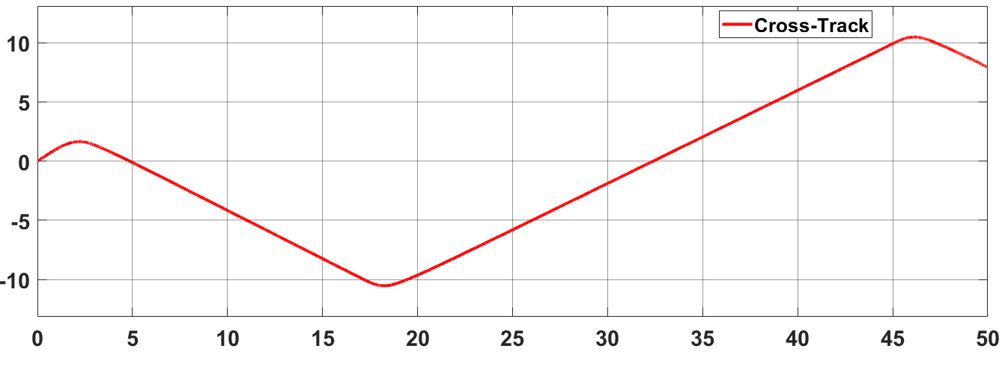
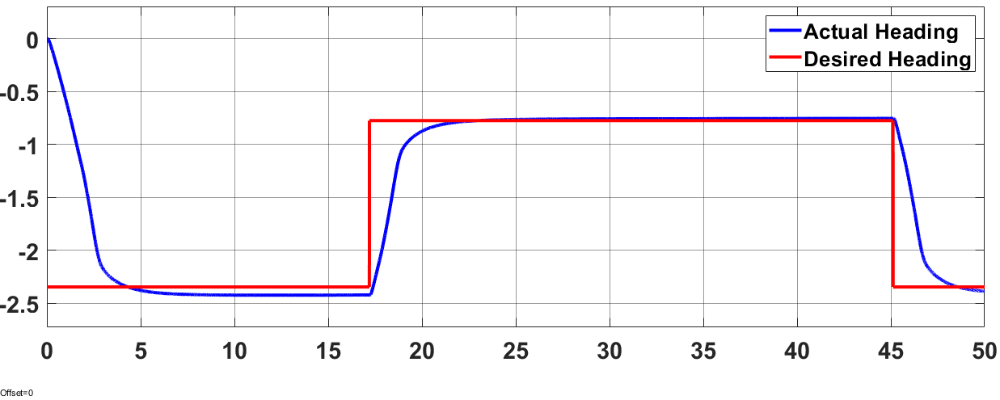
Motion Control: Direct Tack
Introduction
Overview
Sailboat Simulation
Motion Control
Future Work

Slide 31
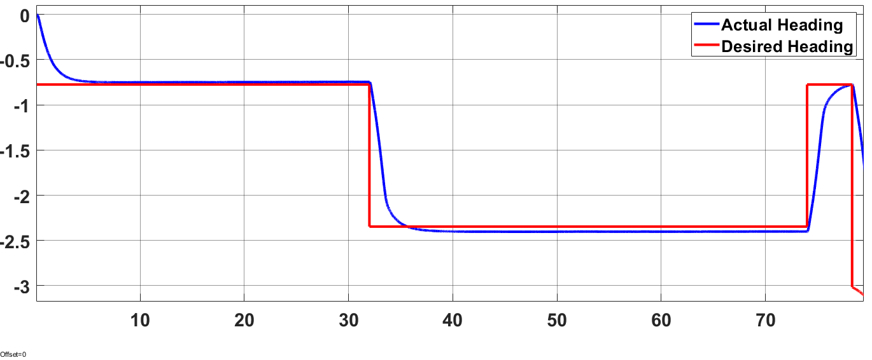
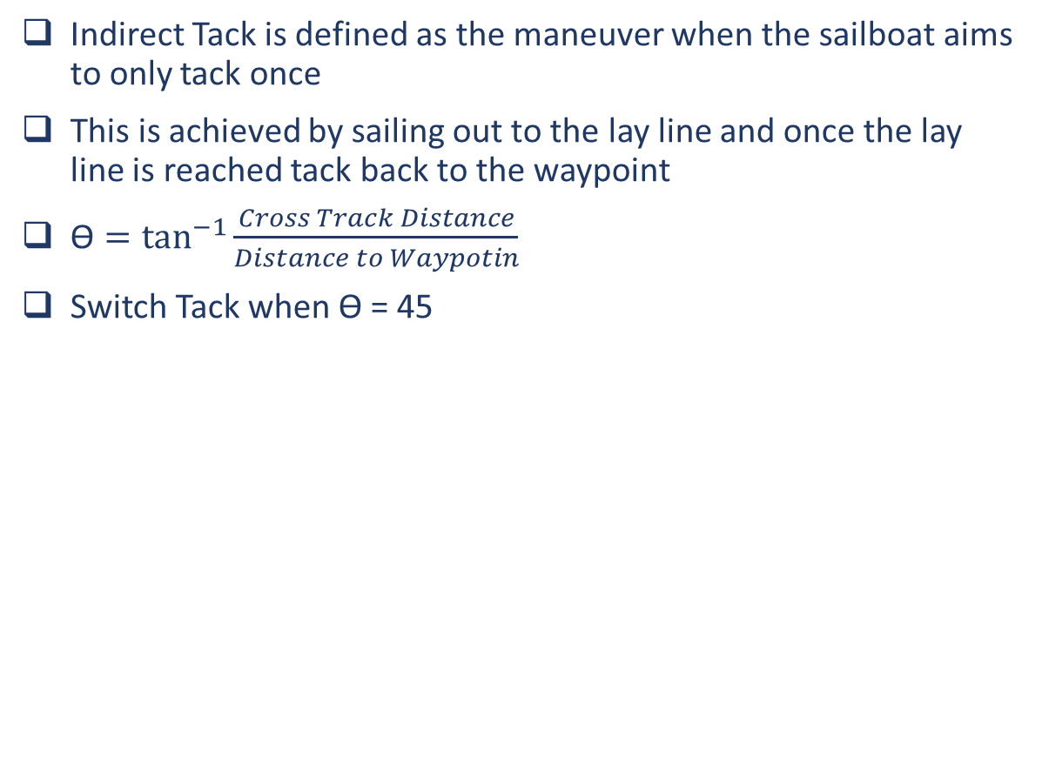
Motion Control: Indirect Tack
Indirect Tack is defined as the maneuver when the sailboat aims to only tack once
This is achieved by sailing out to the lay line and once the lay line is reached tack back to the waypoint
$\text{ϴ}=\tan^{−1}{\frac{Cross Track Distance}{Distance to Waypotin}}$
Switch Tack when ϴ = 45
Introduction
Overview
Sailboat Simulation
Motion Control
Future Work

Slide 32
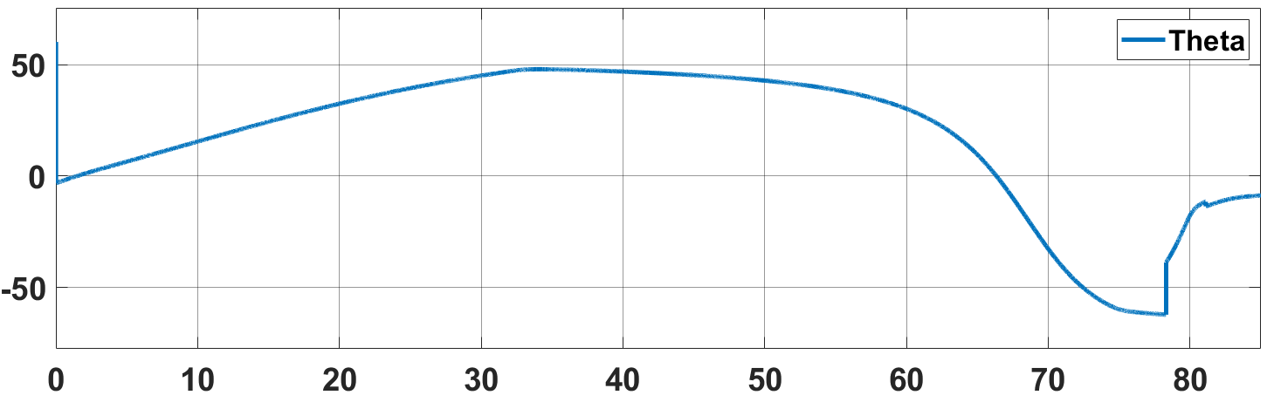
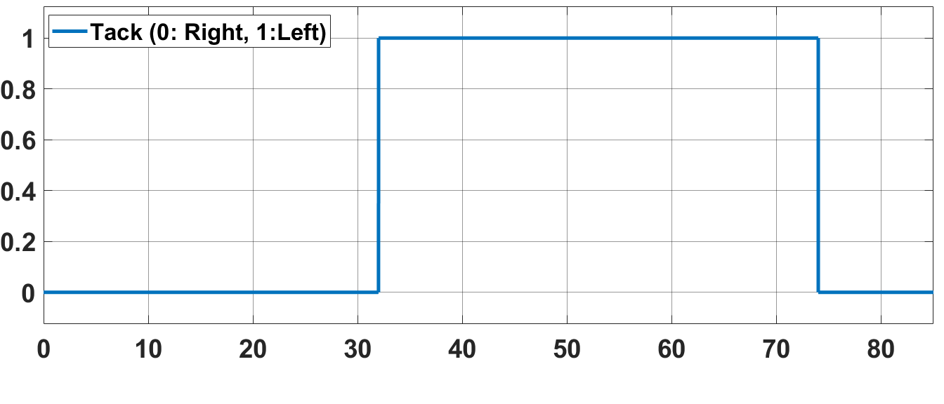
Motion Control: Indirect Tack
Introduction
Overview
Sailboat Simulation
Motion Control
Future Work

Slide 33
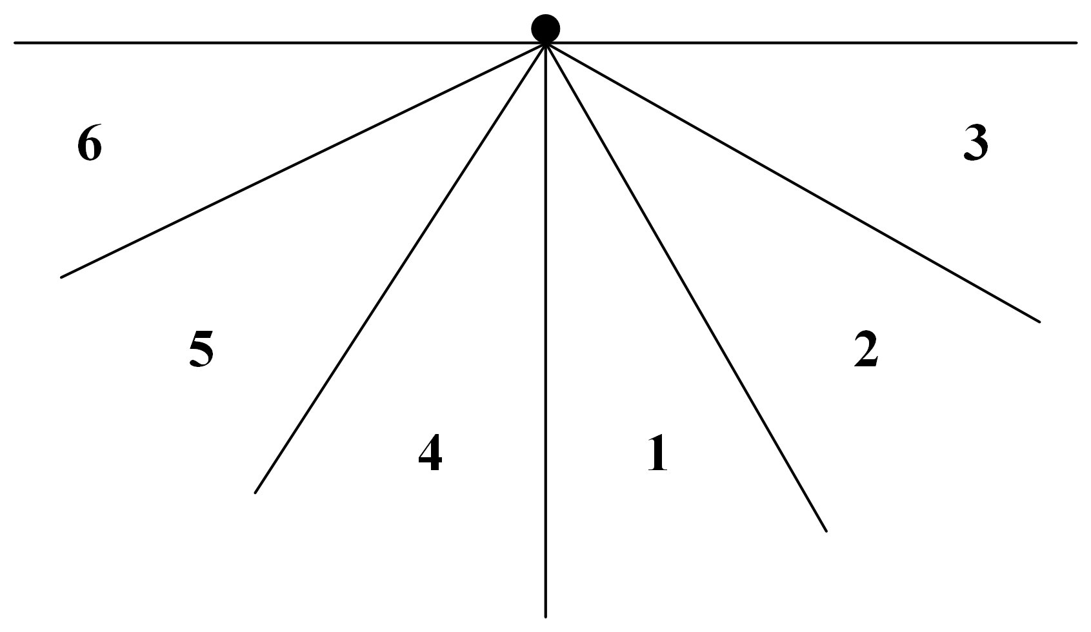
Motion Control: Zone Tack
Zone/Dynamic tack considers the wind angle when tacking
A tack switch is only performed when the wind forces it
Define zones 1-6, sailboat tries to remain inside zones 1,2,4 and 5 when tacking
Zones are calculated by offsetting the waypoint heading with wind angle
Introduction
Overview
Sailboat Simulation
Motion Control
Future Work

Slide 34
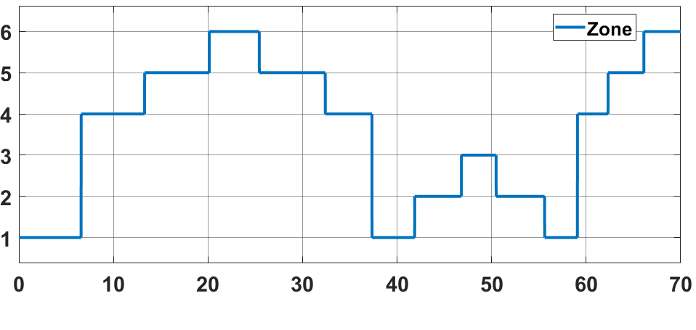
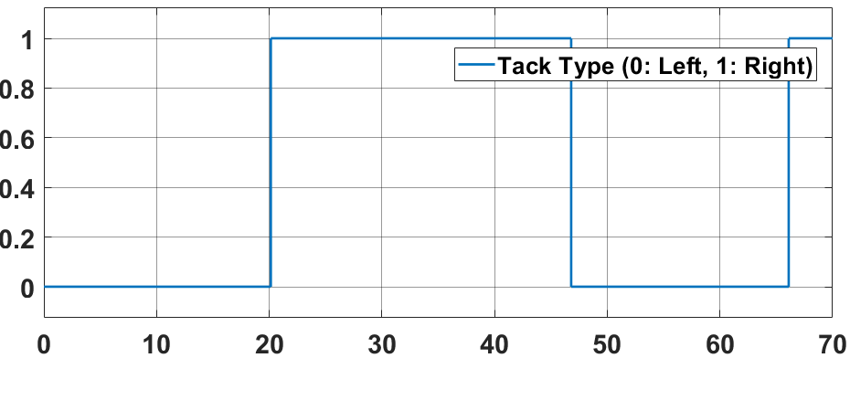
Motion Control: Zone Tack
Introduction
Overview
Sailboat Simulation
Motion Control
Future Work

Slide 35
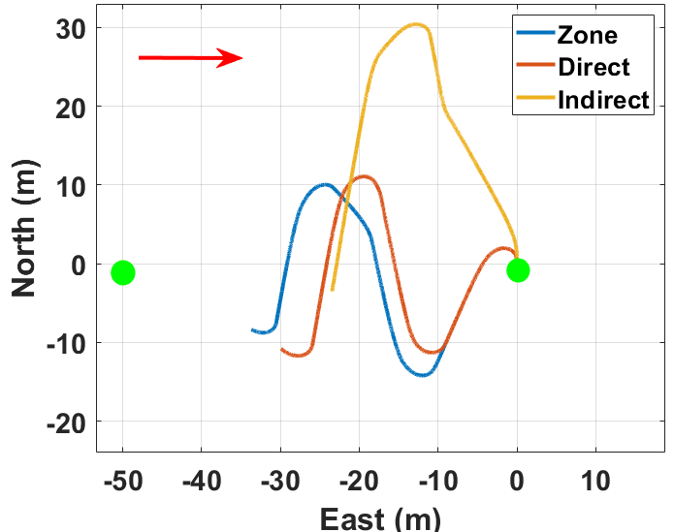
Motion Control: Tacking
Introduction
Overview
Sailboat Simulation
Motion Control
Future Work

Slide 36
Future Work
Continue development in Ardupilot
Develop custom wind sensor
Start with real world testing on sailboat
Possible paper topics
Write up
Introduction
Overview
Sailboat Simulation
Motion Control
Future Work

Slide 37
Questions
Introduction
Overview
Sailboat Simulation
Motion Control
Future Work

Slide 38
Course
Start Gate
Upwind Waypoint
Downwind Gate

